Slide 1

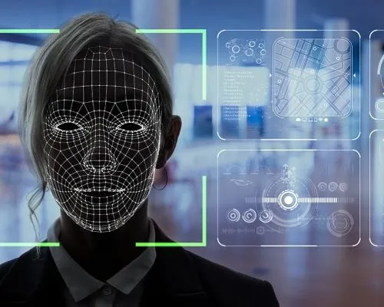
FACE RECOGNITION ATTENDANCE SYSTEM
Name- Rambilas Ganguly
Std. Code- BWU/BTD/21/084
Dept.- CSE- CS & DS

Slide 2
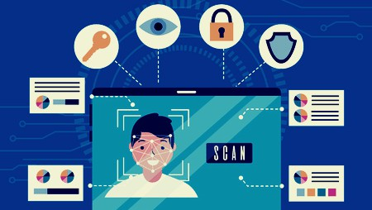
INTRODUCTION
A Face Recognition System using machine learning leverages advanced algorithms to identify and verify individuals based on their facial features. It works by first detecting a face in an image or video frame, then extracting key features to create a unique numerical representation known as a facial embedding. These embeddings are compared against a database of known faces using machine learning models trained to recognize patterns and similarities. This technology provides a highly accurate and efficient method for identity verification, making it ideal for applications such as attendance tracking, security access control, and user authentication. Machine learning enhances the system's ability to improve over time with more data, increasing both reliability and robustness in real-world environments.

Slide 3








Working principle:-
Pic Details
TRAIN
SAMPLE
PHOTO
DATA
SAMPLE
IMPORT
EXPORT
SAVE
RESET
UPDATE
DELETE

Slide 4
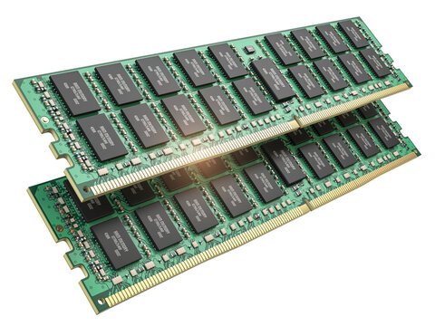




STORE
OUTPUT
PHOTO
DETECTION

Slide 5
FUTURE SCOPE
The future of face recognition using machine learning is highly promising, with improvements in accuracy, speed, and adaptability to various conditions. It can be integrated into smart classrooms, mobile apps, and surveillance systems for real-time use. Future systems may also analyze student engagement and behavior, making learning environments more intelligent. With proper privacy measures, it can expand to sectors like banking, healthcare, and public safety.

Slide 6






